Slide 1

WEB PORTAL
AUTOMATED TIMETABLE
GENERATOR SYSTEM

Slide 2
PRESENTED BY
SOUMI SINGHA
ABHIJIT DAS

Slide 3
PROJECT SUMMARY
WEB PORTAL is an timetable generator portal where the all data of teachers and students are recorded.
Teachers can schedule their classes and students can check it through this website called WEB PORTAL.

Slide 4
RECUIRMENTS AND SPECIFICATIONS
SOFTWARE REQUIRMENTS
Operating System : Windows 10/2019
Front-End Tool : HTML,CSS, JAVASCRIPT.
Back-End Tool : MySQL
Programming Languages : PHP
HARDWARE REQUIRMENTS
Processor : Intel Pentium to any updated
Processor Speed : 250MHz to 667 MHz
RAM : 2GB
Hard Disk : 80 GB

Slide 5
COCOMO(CONSTRUCTIVE COST MODEL)
Cocomo (Constructive Cost Model) is a regression model based on LOC, i.e number of Lines of Code. It is a procedural cost estimate model for software projects and often used as a process of reliably predicting the various parameters associated with making a project such as size, effort, cost, time and quality. It was proposed by Barry Boehm in 1970 and is based on the study of 63 projects, which make it one of the best-documented models.
Organic-
COCOMO Model–The Constructive Cost Model is a software cost estimation model based on an algorithm. It was developed by Barry Boehm first published in 1981 Barry W. Boehm’s Book Software engineering economics as a model for estimating effort, cost, and schedule for software projects.
COCOMO applies to three classes of software projects:

Slide 6
Organic projects- “small” teams with “good” experience working with “less than rigid” requirements.
Semi-detached projects- “medium” teams with mixed experience working with a mix of rigid and less than rigid requirements.
Embedded projects- developed with a set of “tight” constraints (hardware, software, operational,..)
BASIC COCOMO equations-
• EFFORT(E)= person month
• Time for Development (Tdev)= Month
Here, KLOC-Thousands or kilos of lines of code
Software Project | a1 | b1 | c1 | d1
Organic | 2.4 | 1.05 | 2.5 | 0.38
Semi-Detached | 3.0 | 1.12 | 2.5 | 0.35
Embedded | 3.6 | 1.20 | 2.5 | 0.32

Slide 7
CALCULATIONS: here the values depend on the types of software products or projects.
We have just told that our software project is of organic type. So according to that the values of
a1=2.4
b1=1.05
c1=2.5
d1=0.38
In our project the estimated line of code(LOC) is 4140. So the estimated size of the project is
4.14 KLOC. Hence considering it to be organic software the
following is calculated
We know that, Effort=person month
=2.4*(2.7)1.05PM
=7.1147 PM
Finally, Time for Development (Tdev)= Months
=2.5*(7.1147)0.38 Months
=2.9856 Months
≈ 2 Months

Slide 8
ENTITY RELATIONSHIP DIAGRAM

Slide 9
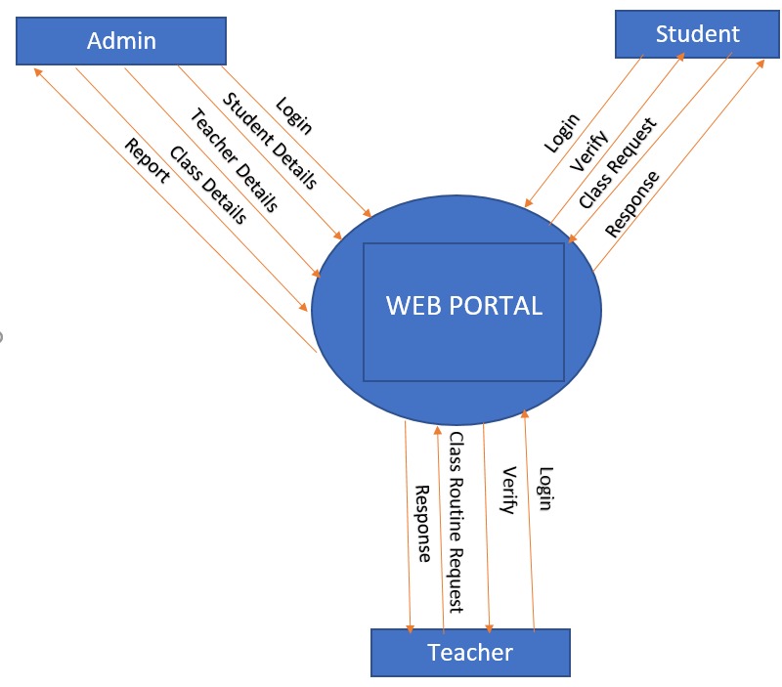
DATA FLOW DIAGRAM
LEVEL 0

Slide 10
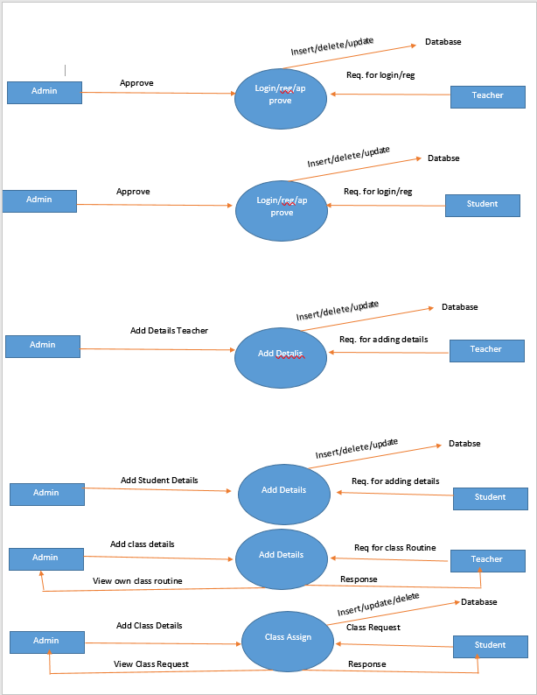
DATA FLOW DIAGRAM
LEVEL 1

Slide 11
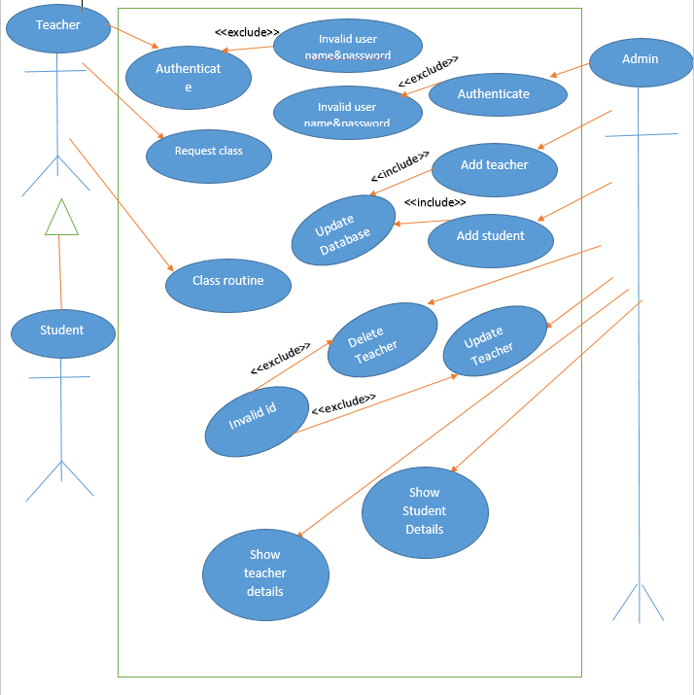
USE CASE DIAGRAM

Slide 12

HOME PAGE

Slide 13
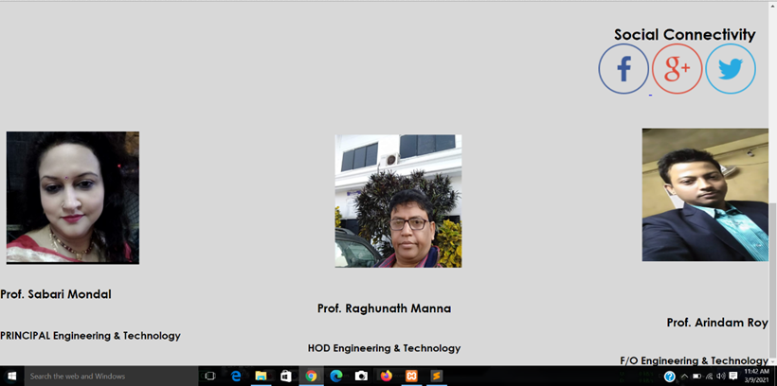

Slide 14
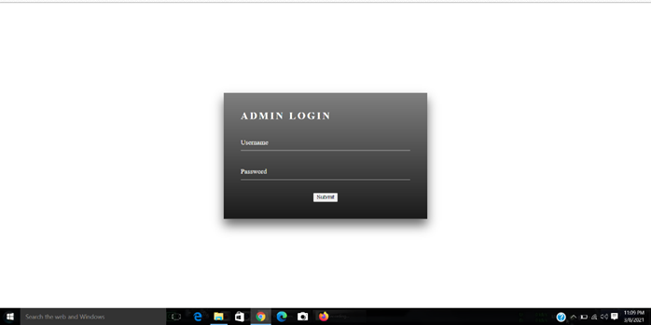
ADMIN LOG-IN

Slide 15

ADD TEACHER AND STUDENT DETAILS

Slide 16
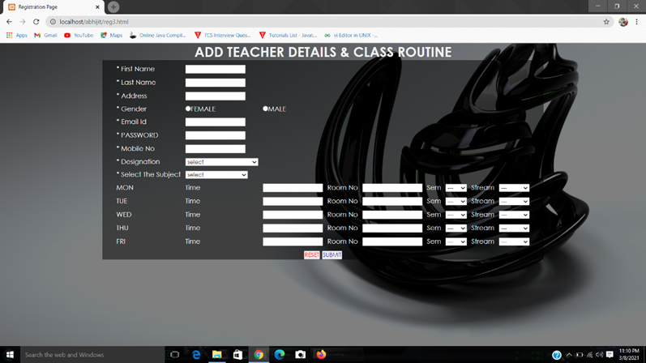
ADD TEACHER AND CLASS ROUTINE

Slide 17
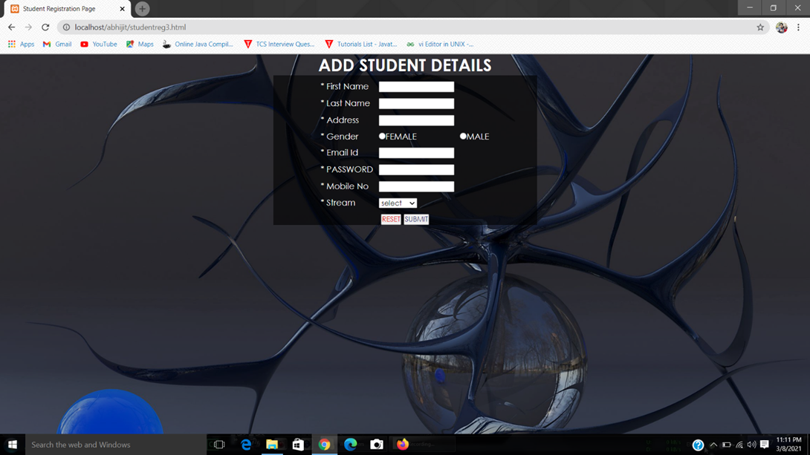
ADD STUDENT DETAILS

Slide 18
TEACHER DETAILS

Slide 19
TEACHER DETAILS

Slide 20
SHOW STUDENT LIST

Slide 21
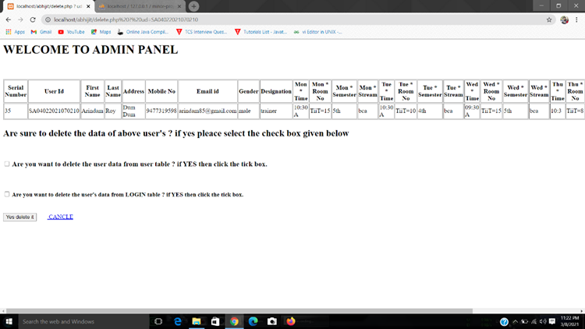
ADMIN DELETE PANNEL

Slide 22
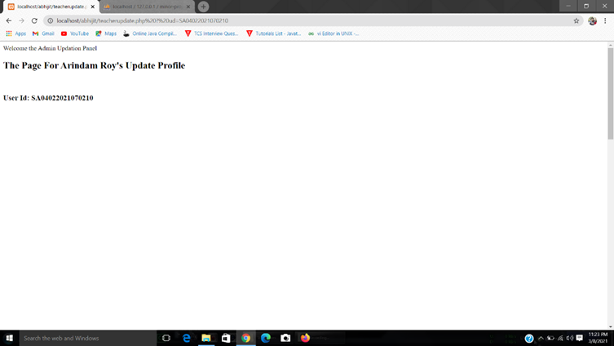
ADMIN UPDATE PANNEL

Slide 23
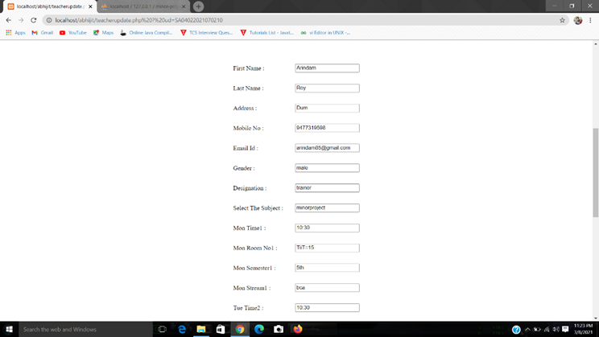

Slide 24
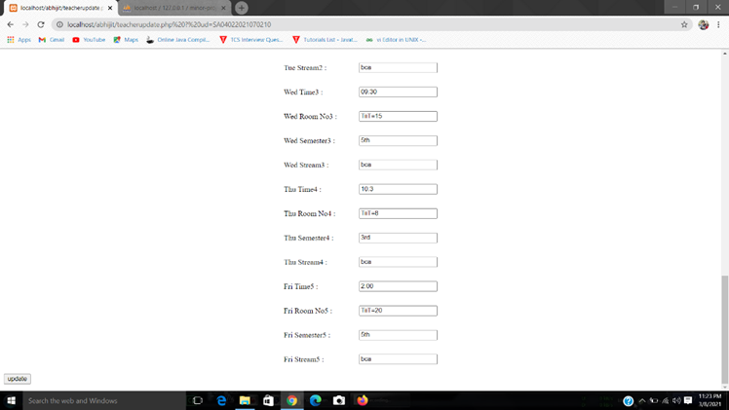

Slide 25
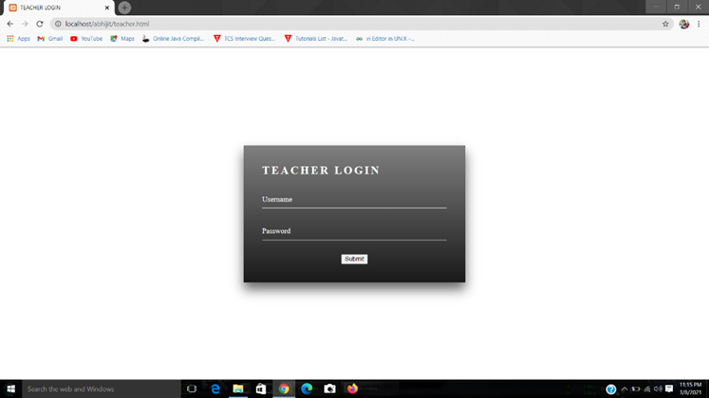
TEACHER LOG-IN

Slide 26
TEACHER’S OWN ROUTINE

Slide 27
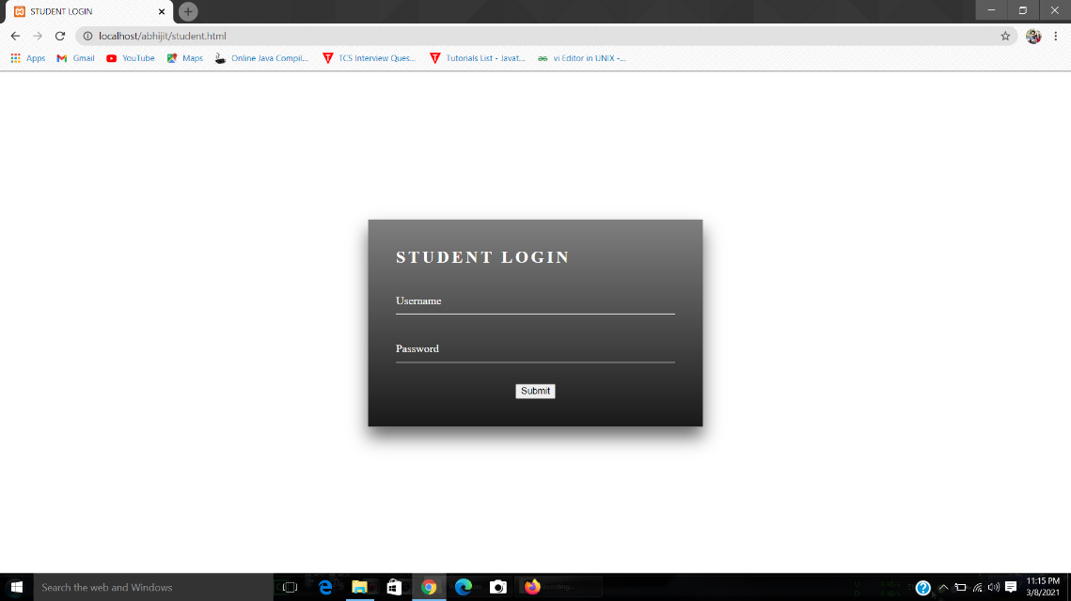
STUDENT LOGIN

Slide 28
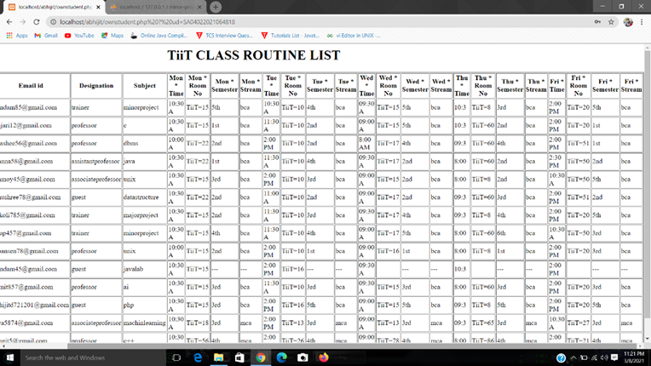
STUDENT CLASS ROUTINE

Slide 29
FUTURE SCOPE
In future the Automatic Time Table Generator System can be used for the attendance system also, by which the teacher and student attendance problem can be solved. Different roles can be added to enhance security of time table such as Administrator, user.

Slide 30
CONCLUSION
Automated Timetable generator System, titled “Class Timetable”, is a web-based project with the aim of providing the details of teachers, students and class routines in an university web portal, where teachers can add/change or delete class timings and students can enter in the web portal through their login id and password to check their classes and timings.

Slide 31
REFERENCE AND BIBLIOGRAPHY
1) Google.
2) YouTube.
3) https://www.javatpoint.com/
4) https://www.geeksforgeeks.org/

